Slide 1
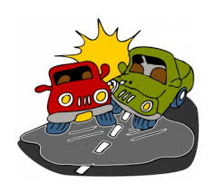
Motor Vehicle Crashes
Santosh Muniswamygowda Nagaraja
ID- 1015433

Slide 2

Data Set
The Data set is obtained for the website www.data.gov. Published by the state of New York.
Link - https://catalog.data.gov/dataset/motor-vehicle-crashes-vehicle-information-beginning-2009
The data set consists of more than 1,500,000 records.
The data set consists of information such as
1. Date of the incident
2. State of the driver
3. Gender of the driver
4. Vehicle model

Slide 3
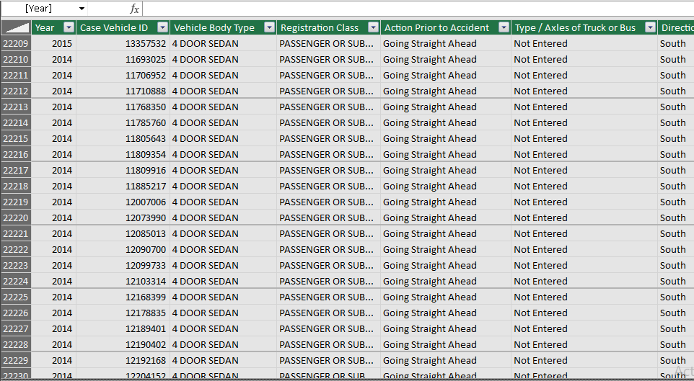
Sample data set

Slide 4
Why this data set?
Examining this data set can help save lives
Determine a pattern where most number of accidents have occurred and find a solution
Sample solution changing the speed limit.
Increase security where most number of drink and drive accidents have occurred.
Check the condition of the road where there is a pattern of accidents.
Check if a particular car model has occurred in most number of accidents.

Slide 5
THANK YOU

